Slide 1
L₁ pattern matching lower bound
Auther : Ohad Lipsky , Ely Porat

Slide 2

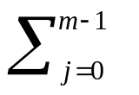


Abstract
Let a text string T = t₀,t₁,…,t_{n-1} and a pattern string
P = p₀,p₁,…,p_{m-1}, t_{i} , p_{j} Ν be given.
In the Approximate Pattern In the L₁ metric problem (L₁ matching
for short) the output is, for every text location i, the L₁ distance
between the pattern and the length m substring of the text starting
at i, i.e. | t_{i+j} - p_{j} |.
The Less Than Matching problem is that of finding all locations of
T where t_{i+j} p_{j} , j = 0 , … , m-1.
The String Matching with Mismatching problem is that of finding
the number of mismatches between the pattern and every length m
substring of the text. For the three above problems, the fastest known
deterministic solution is time.
In this paper we show that the latter problems can be linearly reduced
to the problem of L₁ matching.

Slide 3
String Matching with Mismatching problem
T = AGCT
P = GT
m₁ : AG
GT => 2
m₂ : GC
GT => 1
m₃ : CT
GT => 1
Output m = 211

Slide 4
Approximate Pattern In the L₁ metric problem
T = 1234
P = 24
d₀ = |1-2| + |2-4| = 3
d₁ = |1-2| + |2-4| = 1
d₂ = |1-2| + |2-4| = 1
Output d = 311

Slide 5


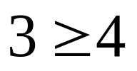


Less than Matching problem
T = 1234
P = 24
i = 0
i = 1
i = 2
Output = 2

Slide 6
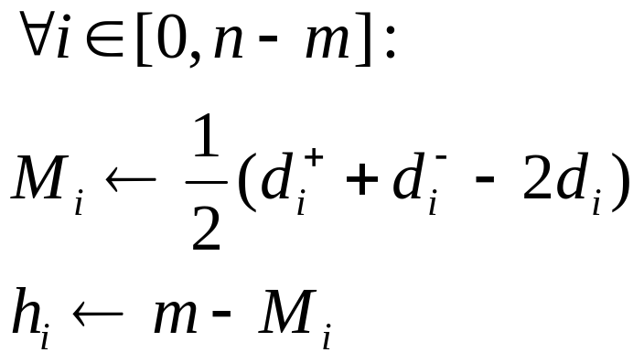
Reduction from String Matching with Mismatching
Construct P⁻ to be p₀-1, p₁-1,…, p_{m-1}-1 and P⁺ to be p₀+1, p₁+1,…, p_{m-1}+1
Let d⁺ to be the output of L₁ matching of T and P⁺,
d⁻ to be the output L₁ matching of T and P⁻ ,
d to be the output L₁ matching of T and P .

Slide 7
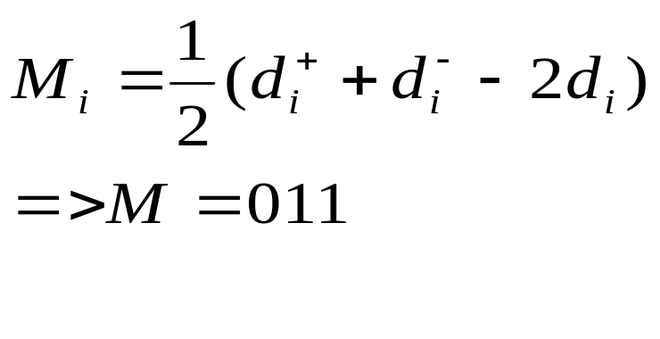
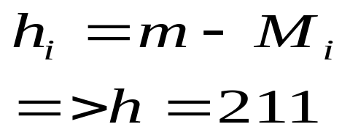
Reduction from String Matching with Mismatching
T = AGCT => 1234
P = GT => 24 d = 311
P⁺ => 35 d⁺ = 531
P⁻ => 13 d⁻ = 113

Slide 8
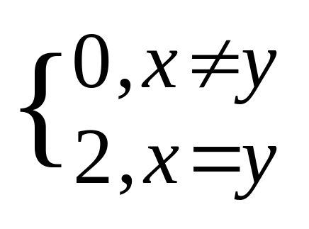
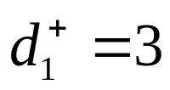
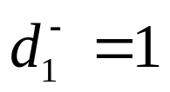
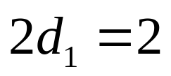
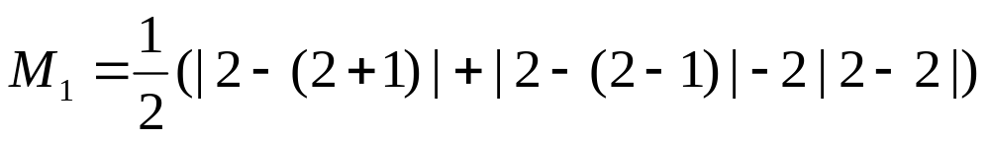
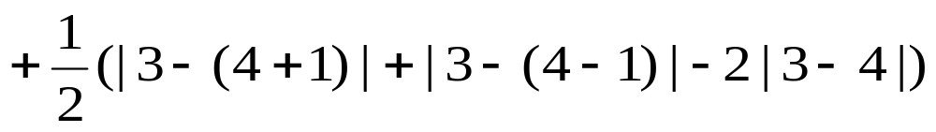
Lemma 1
= 1+0
= 1
T = 1234
P = 24
Notes:
i>, j= , k< , i+j+k = m
d = x
d⁺ = x+i+j-k => M =1/2(d⁺ + d⁻ - 2d) =1/2[(x+i+j-k)+(x-i+j+k)-2x] = j
d⁻ = x-i+j+k

Slide 9
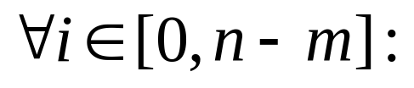

Reduction from Less Than Matching
Let d to be the output of L₁ matching of T and P,
and d⁺ to be the output of L₁ matching of T⁺ and P.
if then output location i is a mach.

Slide 10
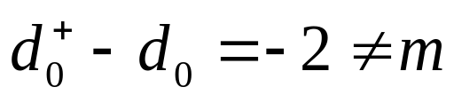
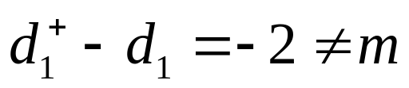
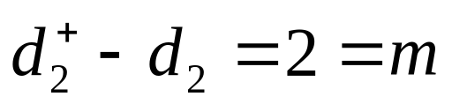
Reduction from Less Than Matching
T = 1234 => d = 331
T⁺ = 2345 => d⁺ = 113
P = 24

Slide 11
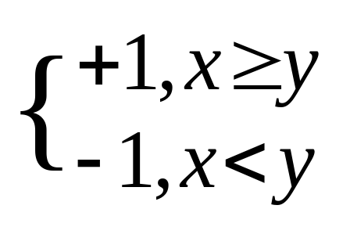
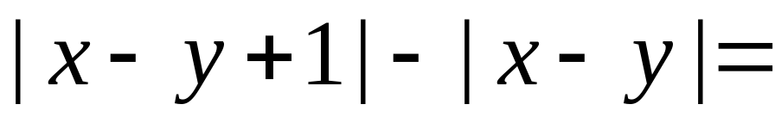
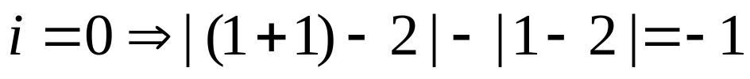
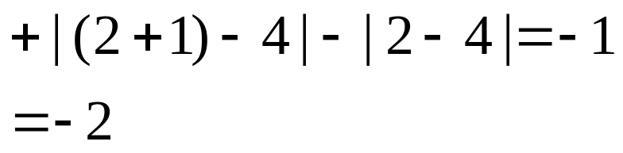

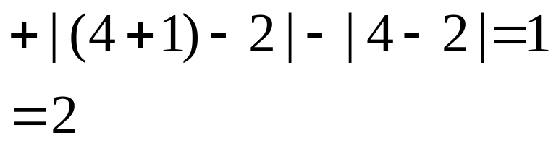
Lemma 2
T = 1234
P = 24

